Slide 1



Slide 2
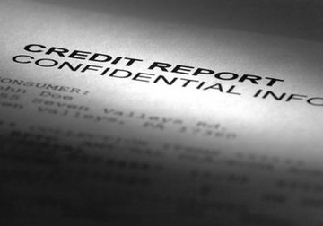
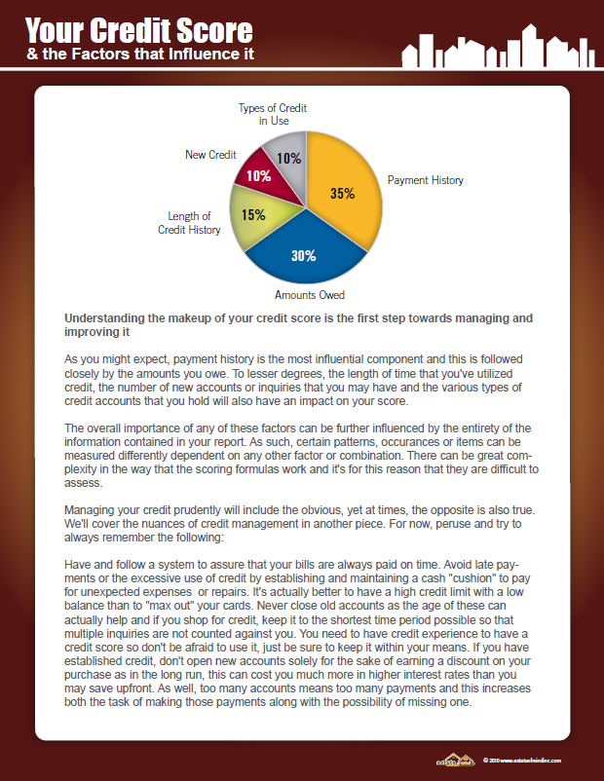
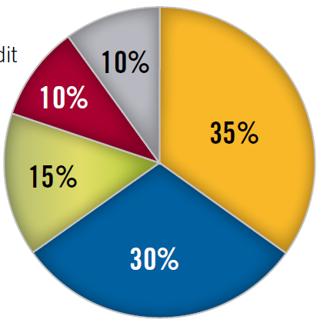


Slide 3
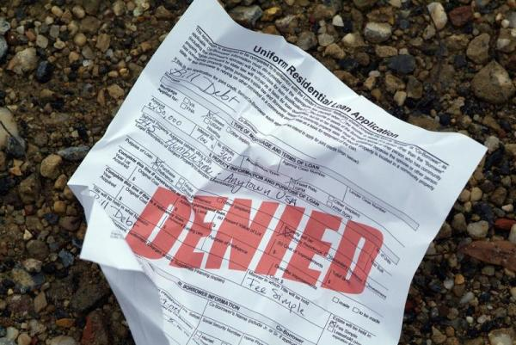
How do we avoid
THIS?

Slide 4

What’s
Most
Important?

Slide 6
Payment History

Slide 7
It’s in that obvious category
but it’s still worth saying…

Slide 8
Have a system that assures you pay your bills
without fail

Slide 9
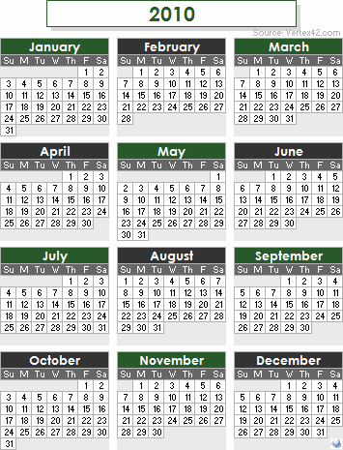
And do it
on time…
every single month

Slide 10
2nd

Slide 11
Amounts Owed

Slide 12
When it comes to credit scores
“Common Sense”
Does not always apply

Slide 13
So it’s actually best to have high credit lines
with low balances

Slide 14


Slide 15
Length of
History

Slide 16

Once again,
“Common Sense”
Has left the building

Slide 17
Do NOT
close old accounts
Longer history on accounts paid timely
= better scores

Slide 18
So use them on occasion
Then pay them off quickly

Slide 19


What else?

Slide 20
New
Credit

Slide 21
You’ve seen all the offers

Slide 22










Slide 23



Slide 24

Because
new accounts will hurt
your scores

Slide 25

Saving $30 today

Slide 26

Can cost
You
thousands
tomorrow

Slide 27

Lastly…

Slide 28
Types of Credit

Slide 29

Variety
Is
Good!

Slide 30
Maintain a mix of: revolving
Installment & secured accounts

Slide 31


Slide 32
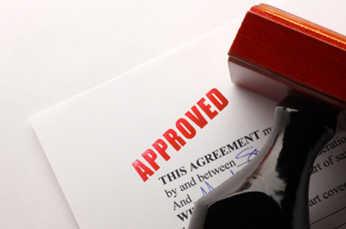
It’s not always
easy but it is
worth
the
effort…

Slide 33

And If you
need
Help!
I’m always
available
to help

